Slide 1
Date: February 3, 2021
Rev. 00a [AE]
INSTALLATION, OPERATION AND MAINTENANCE MANUAL
SMART CHANNEL

Slide 2
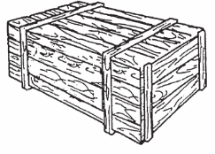
PRELIMINARY CHECK
No special tools are required for installation.
Before starting the installation, check that all goods in the packages were not damaged during transportation.
UNPACKING, HANDLING, RECEPTION, STORAGE
UNPACKING
The goods are supplied in suitable packing (pallet, box, drum, etc.). Wooden packages, if present, are fumigated according to applicable international norms. Wrapping is suitable for standard handling conditions. Goods delivered in wooden boxes may be secured with blocks.
To handle with packages, always use equipment suitable for the type of package to handle and its weight. Never tilt or turn packages upside down.
If the package is handled with forklift truck, make sure weight is balanced on forks.
If the package is handled with a hoist, a crane or different hooking equipment, make sure the load is balanced. Always use legally certified lifting equipment and pay attention to the safety of people and property.
When lifting and laying down a package, avoid impacts and bumps.
HANDLING
IOMMANUAL 80PU – Rev. 01 (03-Feb-2021) – 2

Slide 3
RECEPTION
When packages are opened, inspect them and make sure packages and their contents have not been damaged during transportation or handling.
Before taking goods out of a package, make sure it is solidly attached to the forklift truck (or different handling equipment) and cannot slide or flip over. If present, remove blocks inside boxes before taking goods out.
Do not walk on packages.
Do not stack anything on packages.
Store packages in cool, dry and clean areas.
Do not store materials inside open packages.
Keep packages away from passageways.
STORAGE
IOMMANUAL SMART CHANNEL – Rev. 01 (03-Feb-2021) – 3

Slide 4
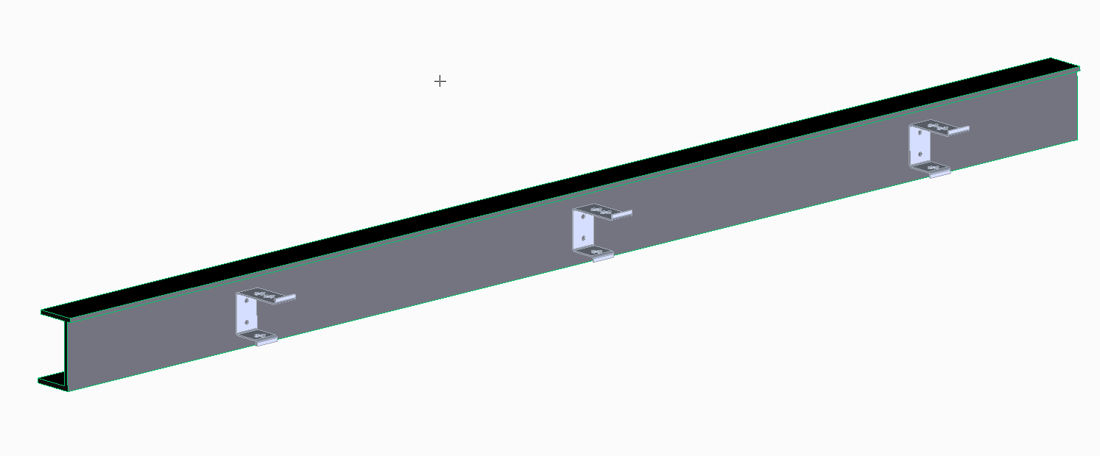
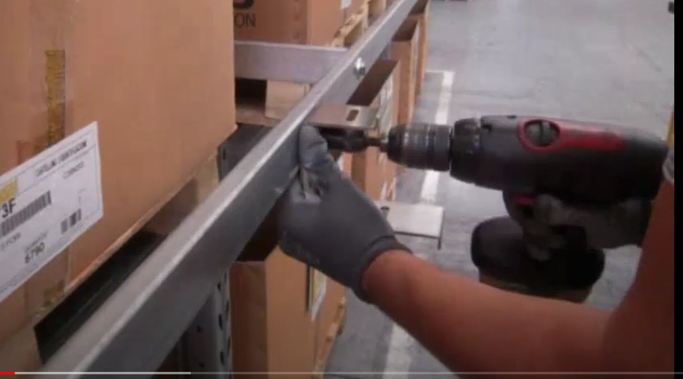
GUIDE CHANNEL INSTALLATION
PREPARATION
Prepare the surface where the guide channel will be installed. The surface must be clean, flat, and free from objects or obstructions along the whole travel distance.
ASSEMBLY
Base profile and empty guide channel
2000
Start to assemble the guide channel from the support brackets
Fix the support brackets with the appropriate M10 screws not supplied by Brevetti.
2000
IOMMANUAL 325 – Rev. 01 (03-Feb-2021) – 4

Slide 5
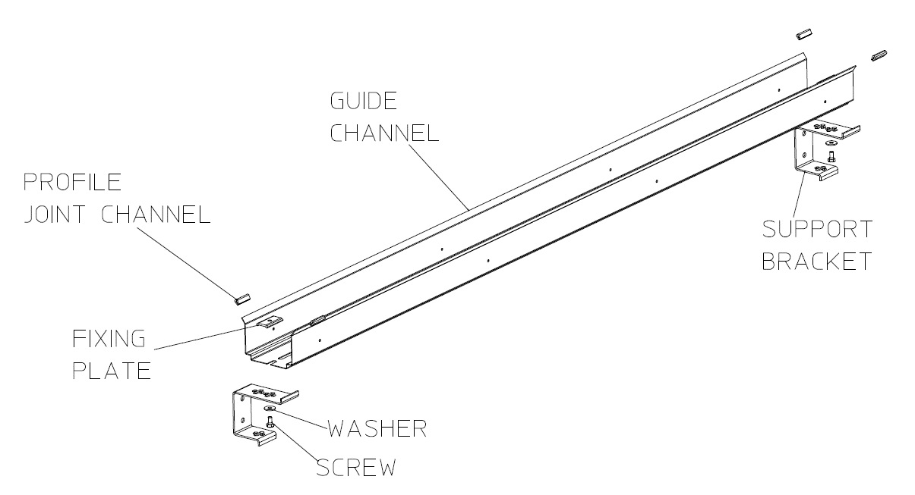
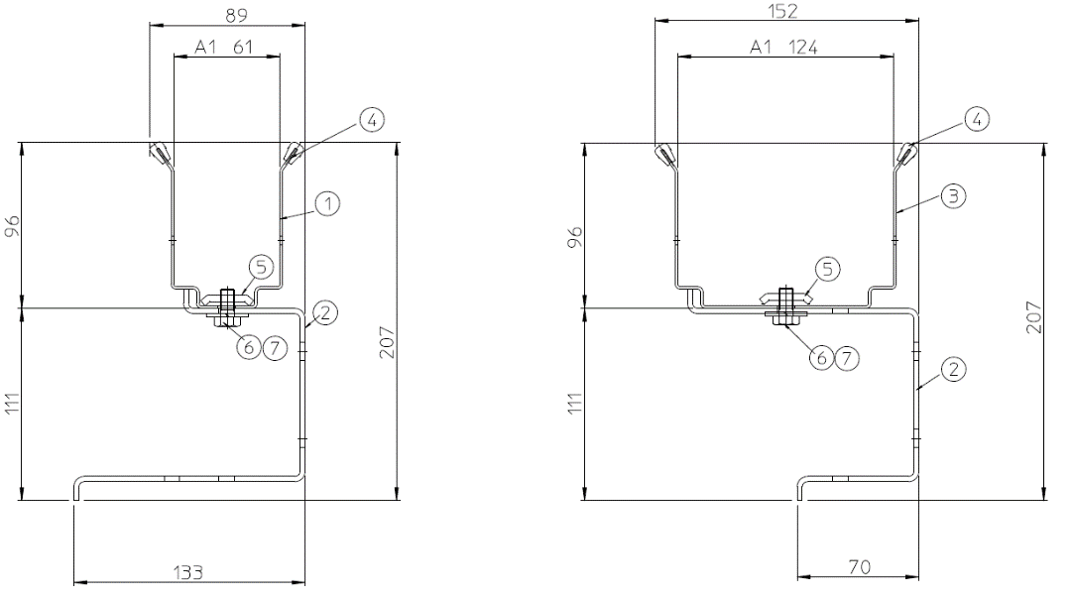
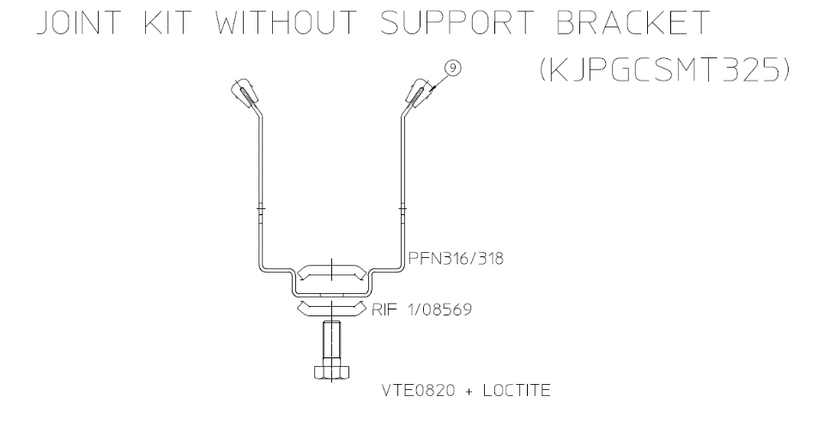
ASSEMBLY
Empty guide channel type CS
DETAIL DIMENSION C=40 mm
DETAIL DIMENSION C=103 mm
ITEM | COMPONENT | ZINC-PLATED STEEL | AISI 304 | AISI 316L | QTY
1 | Side wall C =40 mm | FASM926120B | FASM926120X4B | FASM926120X6B | 1
2 | Support brackets | STDSM70133 | STDSM70133X4 | STDSM70133X6 | 1
3 | Side wall C =103 mm | FASM9212420B | FASM9212420X6B | FASM9212420X4B | 1
4 | Profile joint channel | PGCSMT325 | PGCSMT325 | PGCSMT325 | 2
5 | Fixing plate | RD53152 | RD55182A4 | RD55182A4 | 12
6 | Screw | VTE0816 | DM5AX-AUT | DM5AX-AUT | 12
7 | Washer | RD84242 | RD84242X | RD84242X | 1
Quantities for one 2-m channel trunk
IOMMANUAL–SMARTCHANNEL Rev. 01 (03-Feb-2021) – 5

Slide 6
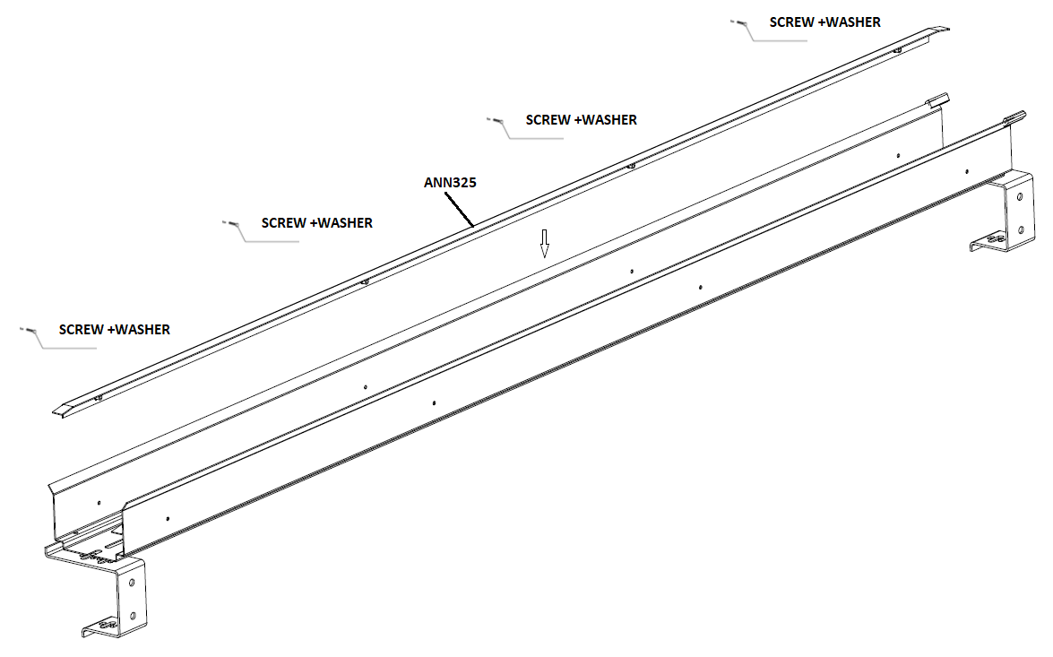
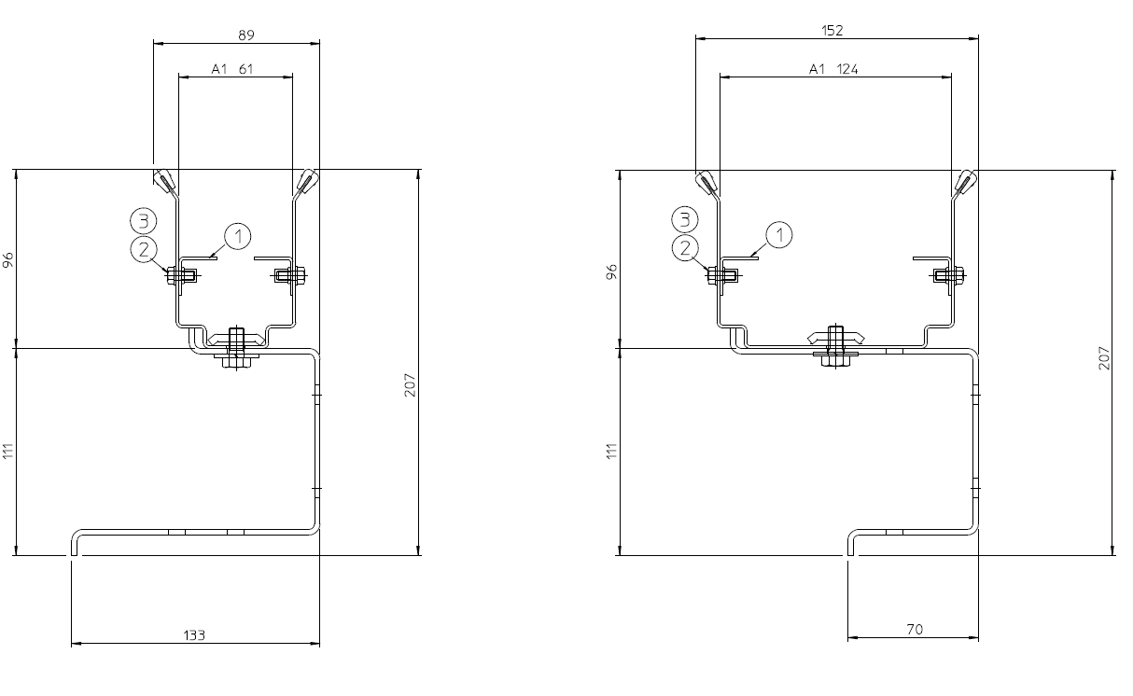
ASSEMBLY
Guide channel type with angular steel CA
The assembly of guide channels with supporting devices is the same as that of the empty channel (CS), with the addition of supporting devices.
ITEM | COMPONENT | ZINC-PLATED STEEL | AISI 304 | AISI 316L | QTY
1 | Stell angular | ANN325 | ANNX325 | ANNX325X6 | 2
2 | Screw | VTE0512 | VTE0512X | VTE0512X | 8
3 | Washer | RD53101 | RD53101X | RD53101X | 8
Quantities for one 2-m channel trunk
IOMMANUAL–SMARTCHANNEL Rev. 01 (03-Feb-2021) – 6

Slide 7
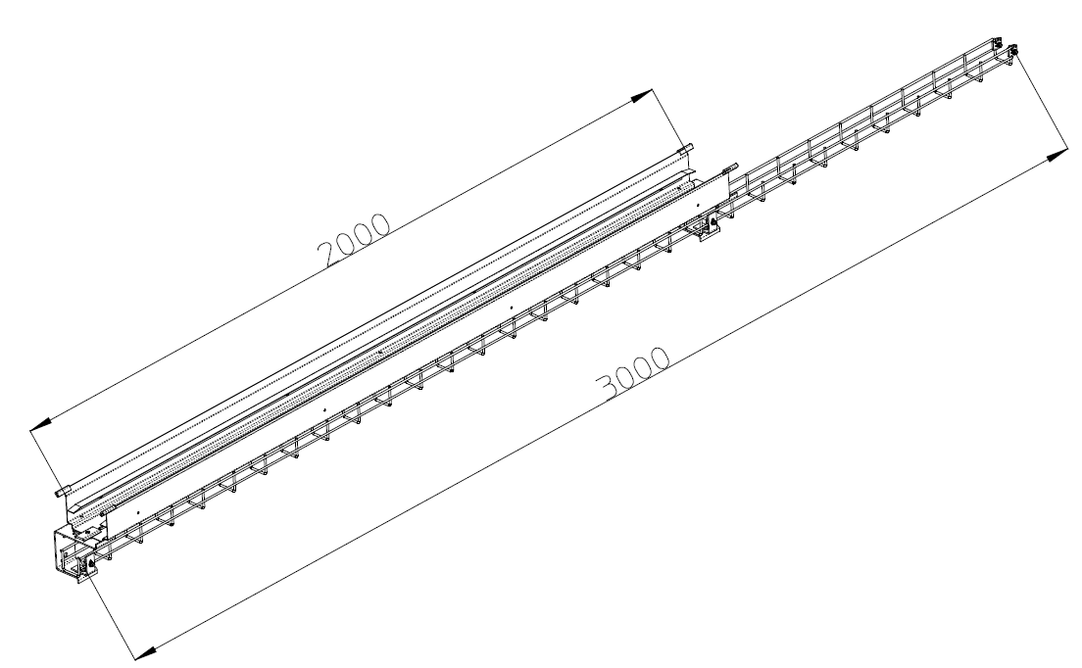
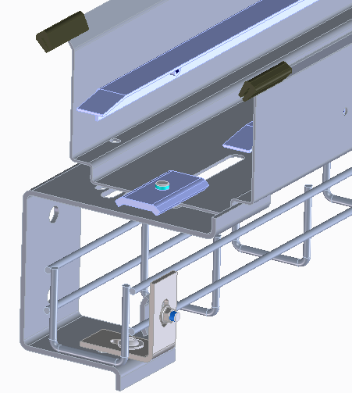
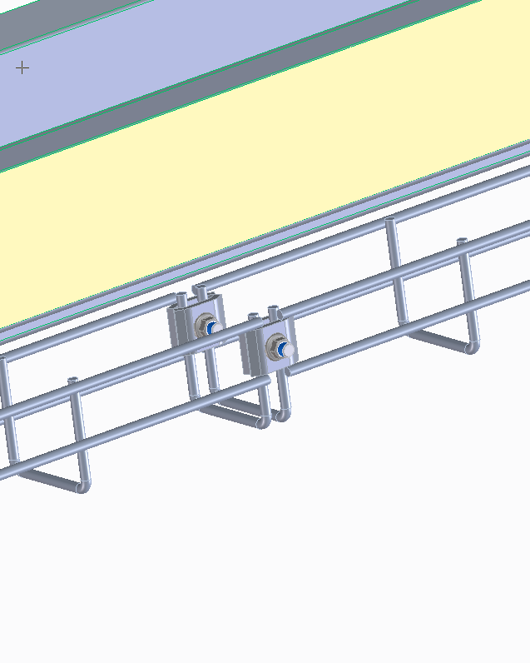
ASSEMBLY
Cable tray for fixed layout
Pay attention to the lenght of Cable tray which is 3 m
Cable tray
IOMMANUAL SMARTCHANNEL – Rev. 01 (03-Feb-2021) – 7

Slide 8
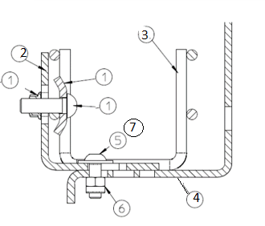
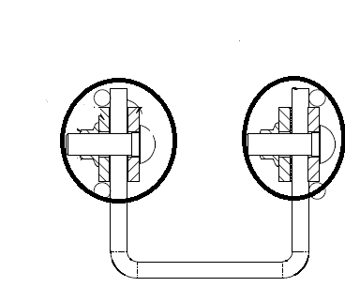
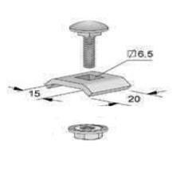
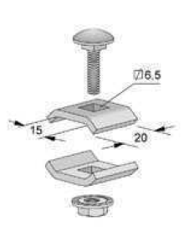
ASSEMBLY
Cable tray for fixed layout
DETAIL FIXING CABLE TRY ON SUPPORT BRACKETS
DETAIL INTERMEDIATE JOINING KJPGCSMT060I
Pay attention to the lenght of fixed guide channel which is 3 m
ITEM | COMPONENT | ZINC-PLATED STEEL | AISI 304 | AISI 316L | QTY
1 | Fixing System | FSRZ | FSRI | FSRI | 1
2 | Fixing brackets | STDSM5050 | STDSM5050X4 | STDSM5050X6 | 1
3 | Fixing cable Try | R6006ZP | R6006I | R6006I | 1
4 | Support brackets | STDSM70133 | STDSM70133X4 | STDSM70133X6 | 2
5 | Screw | VU0516 | VU0516XA4 | VU0516XA4 | 12
6 | Self-locking nut | DM5A-AUT | DM5AX-AUT | DM5AX-AUT | 12
7 | Washer | RD53152 | RD55202X | RD55202X
DETAIL FSRI/FSRZ
DETAIL UURZP/UURI
IOMMANUAL SMARTCHANNEL – Rev. 01 (03-Feb-2021) – 8

Slide 9
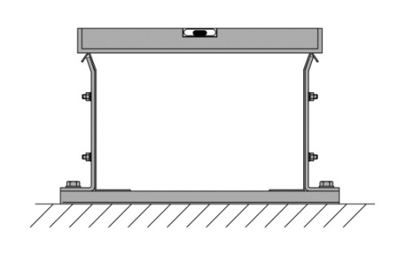
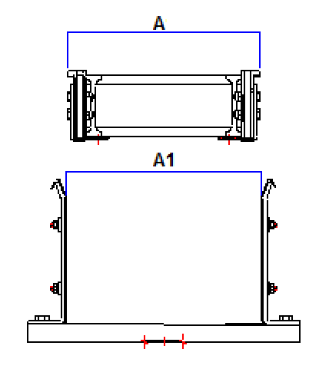
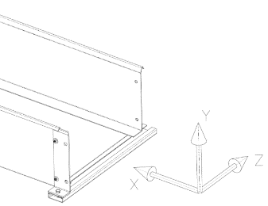
3.2.7 general checks on channel sectors
When channel trunks are assembled, lay them down to form the complete channel. The junction plates are used to connect the sidewalls of adjacent trunks.
While trunks are laid down and bolted, always check planarity and parallelism according to the instructions given in the following paragraphs.
The guide channel must be perfectly flat:
The inner width of channel (A1) must be consistent all along the channel.
3.3 ALIGNEMENT
The assembled guide channel sectors must be installed with precision. The first sector to lay is the central one, and the construction of the channel builds from the center towards the two extremities
IOMMANUAL 80PU – Rev. 01 (03-Feb-2021) – 9

Slide 10
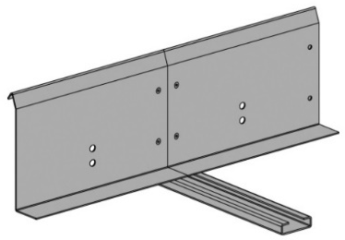
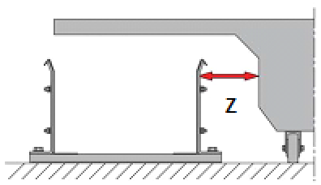
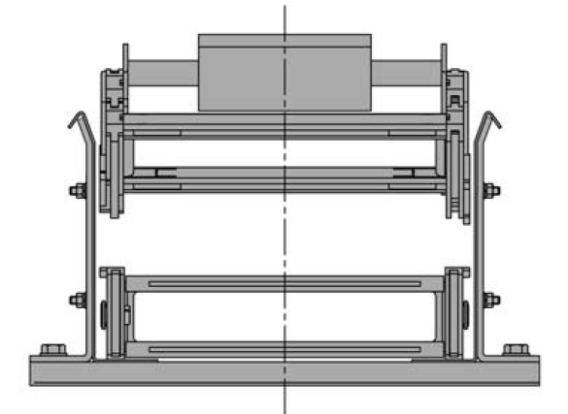
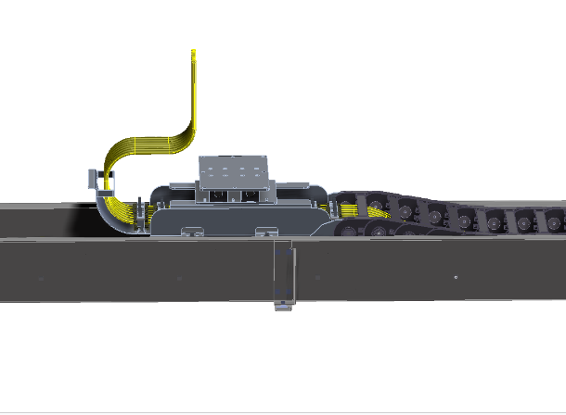
3.3.2 ALIGNEMENT ON Z AXIS
During the alignment phase, verify that no sharp edges are found at the junction between adjacent sidewalls, as that might cause permanent damage to the chain or wrong performance
Make sure to obtain a precisely parallel alignment between the guide channel and the machine rail. It is recommended to use a laser pointer or a straight wire (not supplied by Brevetti).
ATTENTION!
Do not align the guide channel straight against the rail, as it might be misaligned itself. The recommended way to assemble the guide channel is to join the extreme travel positions (A and B in the image below, top view) with a laser pointer or a wire and align sidewalls accordingly.
Make sure the maximum misalignment between the chain and the machine (Z in the above image) falls within the A1/A range, as indicated in the charts at the previous pages of the manual.
← If Z is greater, it is necessary to provide the chain with an anti-misalignment device (supplied by Brevetti Stendalto on request)
IOMMANUAL 80PU – Rev. 01 (03-Feb-2021) – 10

Slide 11
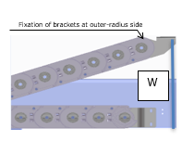
3.3.1 ALIGNEMENT ON Y AXIS
The chain movable point must be installed at the correct height to allow the correct movement of the chain along the travel distance, and the tow arm must respect the tolerance given.
CHAIN | W mm
325 | 140
If the height is not constant and changes significantly along the travel, find the highest point (i.e. the minimum height from the tow arm) and use it as reference height. The areas with different height must be raised through shims to become level with the reference height.
Follow the chart on the top to identify the correct height.
If shimming is required, consider the following recommendations, and make sure to avoid galvanic corrosion between stainless and non-stainless components.
Clearance of 1.5 mm use 1× plastic shim
Clearance of 3 mm use 2× plastic shim
Clearance of 5 mm or more use alternate plastic/SS shims
IMPORTANT! The chart on the left applies only when NO anti-misalignment device is present at the movable point, AND the movable point brackets are fixed at the outer-radius side.
If an anti-misalignment device is present (see image on the right for reference),
or if brackets at the movable point are fixed at the inner-radius side, the required installation height is indicated on the reference drawing.
IOMMANUAL 80PU – Rev. 01 (03-Feb-2021) – 11

Slide 12
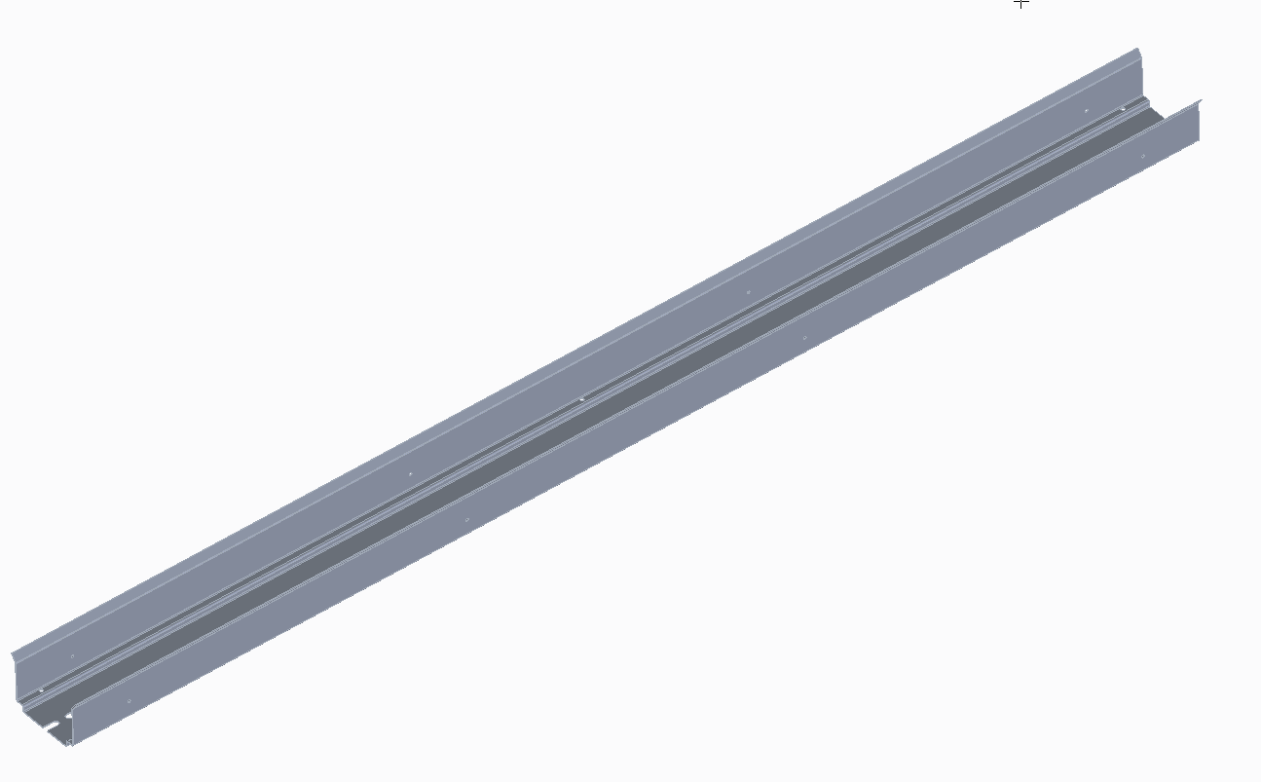
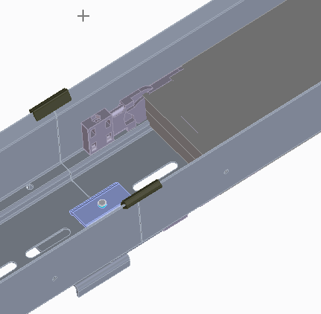
4 LAYING THE CHAIN IN THE CHANNEL
The installation of the chain starts after the guide channel is completely laid out.
4.1 Chain supplied unassembled or in trunks
← Identify the holes where the chain fixed point should go and install the fixed point (which might be supplied with some chain links already joined, as shown on the reference image on the left).
Join the end brackets of the fixed point to the guide channel. →
Lay down the chain trunk after trunk, and make sure to join trunks together in the proper way (read FOCUS for details).
The last trunk to join is the one where the end brackets of the movable point should go. The end brackets of the movable point might have been supplied with some links already joined.
← It might be useful to join trunks after bending them, so the guide channel does not interfere with the operation of joining trunks (see the image on the left).
It is also possible to join chain trunks together before laying the chain inside the channel. This might be useful if the chain is not very long and heavy. Pay attention not to damage the chain while placing it in the channel, especially if the operation is done by pulling the chain that lays on the ground
Once the chain is fully joined and located in the channel, the movable point may be connected to the machine.
IOMMANUAL 80PU – Rev. 01 (03-Feb-2021) – 12

Slide 13
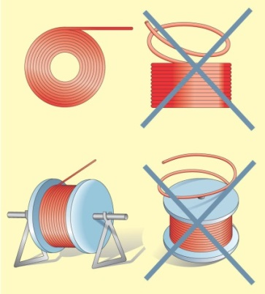
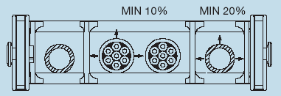
5. INSTALLATION OF UTILITIES
This paragraph provides recommendations on how to deal with cables and hoses used with a cable chain. More information can be found on Brevetti catalogues and utility datasheets issued by OEM’s.
Check the minimum allowed bend radius (MBR) of the chosen utility and compare it with the bend radius of the chain. For a correct installation, the chain bend radius should be equal or bigger than the biggest MBR among utilities.
← Utilities must be installed and unrolled from their bundles or drums carefully to avoid damage. It is important to follow OEM’s recommendations. The utility should not be unrolled from the centre, but rather placed on a support or on a turning plane, and then unrolled starting from the external end.
After unrolling utilities, it is strongly recommended to leave them unrolled on the floor or hung vertically for some hours, to release torsional stress.
Provide adequate space inside the chain:
a cable needs at least 10% of free space;
a hose needs at least 20% of free space.
Organize cables and hoses using suitable separators. If separators move during the insertion, re-position them.
Avoid mixing cables and hoses in the same compartment.
If there is more than one utility in a compartment, the free space should not let utilities get twisted around each other. Tensioning of cables that share the same compartment should be checked very carefully, as cables should follow the chain bend according to their position relative to the chain neutral axis (i.e. cables located at the outer-radius side of the chain should be given more slack than cables located at the inner-radius side).
Install utilities symmetrically in the chain, keeping the larger and heavier ones towards the outside and the smaller and lighter ones at the centre. The weight inside the chain should be balanced.
IOMMANUAL 80PU – Rev. 01 (03-Feb-2021) – 13

Slide 14
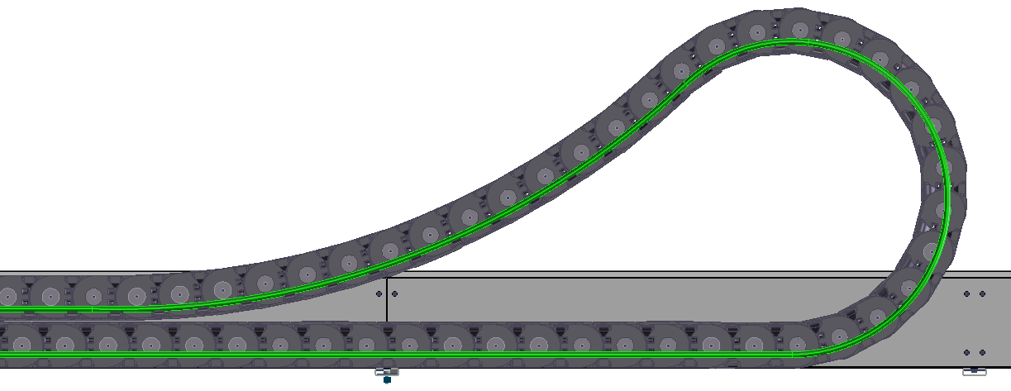
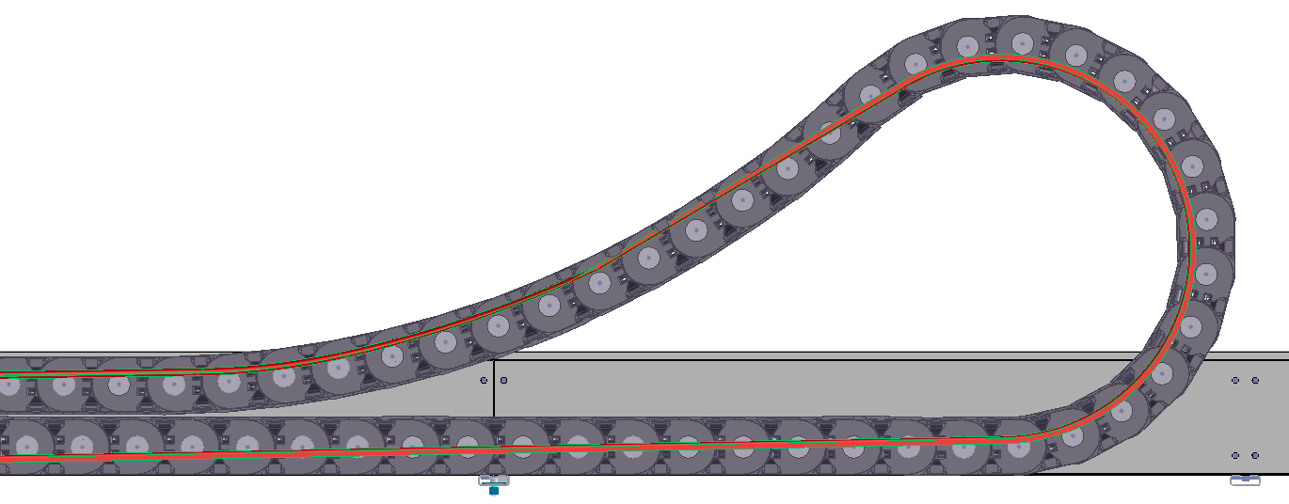
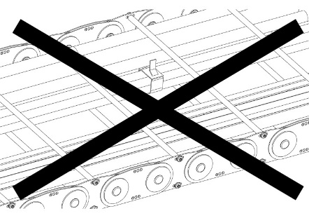
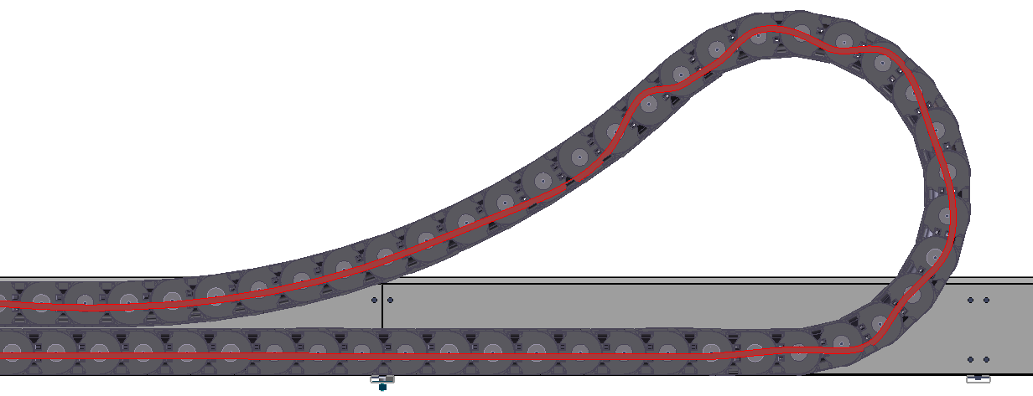
Utilities must be placed and installed so they can move freely longitudinally during the movements of the chain. It must be verified that the behaviour of the utilities at the bend radius does not cause any tension or traction on the chain. If the chain is supplied rolled on a drum, cables must be de-tensioned first, and their position checked immediately after the chain is unrolled and laid inside the guide channel.
Proper tensioning: the cable lays nicely on the chain in the straight part; note the cable is off centre along the bend radius (this will let the cable absorb relative movement with the chain under operation)
Utilities must be fastened using appropriate accessories (tie-wraps, metallic clamps, etc.) at both ends of the chain. Such fasteners might be supplied by Brevetti upon request.
Do not connect or clamp utilities inside the chain. Do not join cables by tie-wraps inside the chain.
Incorrect tensioning: the cable is too tight; it does not lay softly on the chain in the straight part and pushes against the chain inner side at the bend radius – the cable should be pushed into the chain
Incorrect tensioning: the cable is too slack; it snakes inside the chain and tends to push against frames and neighbouring cables to find a way out of the chain – the cable should be pulled out of the chain
IOMMANUAL 80PU – Rev. 01 (03-Feb-2021) – 14

Slide 15
6 APPLICATION TEST
Test the movement over the complete travel distance.
Check that the chain moves free and smoothly.
Check that utilities keep the correct position during the movement.
Check that the Cable Chain System (CCS) is clean, flat, and totally free from edges, screw heads, and any other foreign part.
The operating area of the CCS must be designed so that no event can lead to damaging the CCS under normal work conditions.
The installation of the CCS must be in full accordance with the drawing(s) provided and any other applicable documents. The customers must report a desired modification to Brevetti prior to its implementation, and the modification must be approved by Brevetti in writing to come into warranty.
In any case, Brevetti will not be responsible for the customer’s interpretation of the drawings and other documents released with the goods.
End brackets at both chain ends must be able to be assembled with no tension.
Every part of the CCS must be assembled carefully and completely, to make sure every part is in the correct position.
Maintenance activities must be carried out as specified under Chapter 8. Test intervals always account from the date of equipment commissioning or handover.
After 4 to 8 weeks’ operation (depending on how frequently the CCS is operated), and always depending on the customer’s own evaluation, test results can make it unnecessary to carry out further checks within the time intervals as per Chapter 8. In this case, the test intervals marked with X can be extended to 24 weeks, and simple visual inspection at the given test intervals is sufficient, provided the instructions given at the test point are complied with.
IOMMANUAL 80PU – Rev. 01 (03-Feb-2021) – 15

Slide 16
7 INSPECTIONS AND CHECKS BEFORE START UP
Note: general information is provided; not all checks may be applicable to the application.
7.1 chain check
Check | Y/N | Remarks
1 Are pins and rivets correctly inserted and positioned?
2 Are links unworn and undamaged?
3 Is chain radius complying with the drawing/PO?
4 Are chain screws correctly tightened?
5 Are separators correctly positioned?
6 Are wear signs on rods/nylon frames/aluminum frames absent?
7 Are rods/nylon frames/aluminum frames correctly positioned/bolted?
8 Are skids correctly positioned and with an acceptable amount of consumption material? Thickness should not be less than 2 mm
9 Radius support roller is correctly positioned and working properly?
10 Is the chain length adequate?
IOMMANUAL 80PU – Rev. 01 (03-Feb-2021) – 16

Slide 17
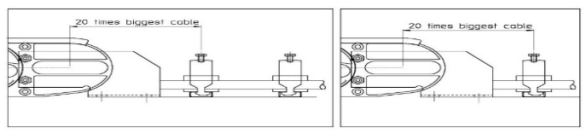
7.2 Movable point check and channel verifications
Check | Y/N | Remarks
11 Are end brackets correctly bolted at the movable point?
12 Are end brackets correctly bolted at the fixed point?
13 Are the overall position and alignment correct?
14 Are cable clamps correctly fitted?
15 Is the chain guided with no constraints in the guide channel?
16 Is the cable exit at the movable point end OK?
17 Is the movable point height acceptable? Check at 4 equidistant points. |  | At ¼ distance from end of retracted side At ½ distance from end of retracted side At ¾ distance from end of retracted side At end of travel
18 Is the tow arm moving straight?
19 Is the alignment between the movable point and the guide channel acceptable? Check at 4 equidistant points. |  | At ¼ distance from end of retracted side At ½ distance from end of retracted side At ¾ distance from end of retracted side At end of travel
20 Is the anti-misalignment device installed correctly and working properly?
IOMMANUAL 80PU – Rev. 01 (03-Feb-2021) – 17

Slide 18
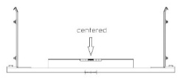
7.3 fixed point check
Check | Y/N | Remarks
21 Is the first guide channel supporting device (CR, CA, CP) mounted at the correct height for smooth chain passage?
22 Are cables coming out of the CCS properly? No sharp edges are allowed in contact with cables.
23 Are cables correctly tensioned?
7.4 guide channel check
Check | Y/N | Remarks
24 Is the length of the guide channel adequate?
25 Is the sliding surface free of dirt deposits?
26 Is the guide channel clear of foreign objects?
27 Are all screws adequately tight?
28 Are guide channel trunks correctly joined? |  | If not, indicate the cause(s): Height difference between trunks. Overlapping of trunks. Screw heads protruding. Excessive gap between trunks. Other: _____________________________
29 Is the guide channel width acceptable? Check every support. You may use a template to check the width.
30 Is the Guide channel support horizontal? Check it every support
31 Are cables correctly guided in the chain?
32 Are all support devices assembled at the right height?
IOMMANUAL 80PU – Rev. 01 (03-Feb-2021) – 18

Slide 19
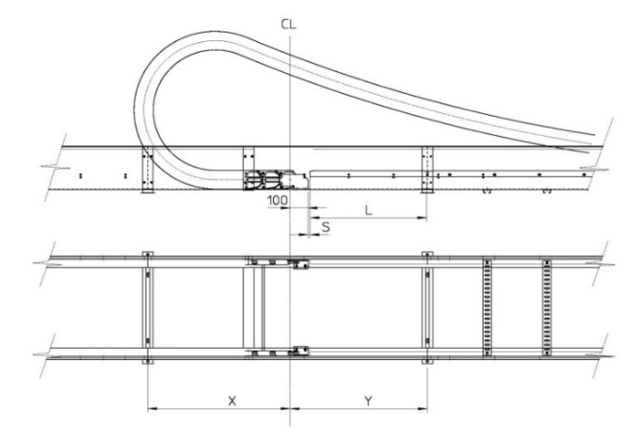
7.5 overall check
Check | Y/N | Remarks
33 Move the trolley against the bumper (end of travel) and verify dimensions N and N1. |  | N: __________ mm |  | N1: _________ mm
34 Check guide channel length and number of sectors. |  | Length: ______ mm |  | No. of sectors: ____
35 Fixed point inspection. |  | S | L | X | Y
IOMMANUAL 80PU – Rev. 01 (03-Feb-2021) – 19

Slide 20
8 MAINTENANCE
8.1 ISPECTION TIME TABLE
Date of commissioning: ___ / ___ / ____ | 1 | 2 | 3 | Notes
Test interval → | At commissioning | Weekly control (for 3 months) | Monthly control (periodic controls) | At commissioning | Weekly control | Monthly control
Item test point
0 Start-up procedure | X
1 Visual inspection of chain for wear (*) |  | X | X
2 Visual inspection of chain for foreign bodies / contamination (*) | X | X | X
3 Link connection | X | X | X
4 Cable tensioning | X | X | X
5 Cable condition | X | X | X
6 Guide channel | X | X | X
7 Movable point | X | X | X
(*) If large particles of dirt, sand, ice or other pollutant accumulate inside the guide channel or on the chain; or if significant evidence of wear is found at inspection; stop the cause at source immediately (e.g. remove sharp edges in the vicinity of the chain which interfere with its operation).
IOMMANUAL 80PU – Rev. 01 (03-Feb-2021) – 20

Slide 21
8.2 ISPECTION ACTIVITY
# | Test point | Procedure | Evidence / Faults | Fault removal
1 | Visual check of chain for wear | Visually inspect the chain. The test is carried out on radius during movement (if possible). | A. Frames worn out. | A. Replace chain because the wear limit has been reached.
 |  |  | B. Significantly more wear on one side. | B. Adjust movable end position.
 |  |  | C. Slight abrasion. | C. Adjust chain alignment.
2 | Visual inspection of chain for foreign parts, dirt Sand, ice, snow after storm | Examine chain for contamination from dirt, foreign bodies, mechanical obstructions. Remove if necessary. After heavy storms with sand or ice, or snow causing unwanted load to the guide channel or the chain, clean the chain and guide channel before moving the chain. Use glycol-based products to melt ice, if necessary (ask Brevetti for guidance and approval). When dirt or foreign objects are discovered, stop the cause at source immediately (e.g. by attaching guard plates or protective grills). | A. Contamination from fine particle; dirt is generally responsible for chain wear. | A. Clean the chain area and links, for example with compressed air.
 |  |  | B. Foreign objects laying between the upper and lower chain portions can cause the chain to block and possibly break down. | B. Remove all foreign objects and carry out a general check of the CCS, especially to verify alignment.
3 | Link connection | Check link connections. Tighten screws if necessary. | A. Unexpectedly high noise while the chain is running. B. Chain wobbling. | Tight link screws adequately.
4 | Cable clamps, cable tensioning | Tighten all clamp screws. Check that clamps are firmly positioned. Tighten base profile screws. Check cable tensioning. | A. Local abrasion on cables. | A. Clamp too loose: tighten it.
 |  |  | B. Cables are loose. | B. Tighten clamp after verifying correct cable tensioning.
 |  |  | C. Plastic saddles missing. | C. Replace whole clamp or put in new saddles.
IOMMANUAL 80PU – Rev. 01 (03-Feb-2021) – 21

Slide 22
# | Test point | Procedure | Evidence / Faults | Fault removal
5 | Cable condition | Bring the bend radius as close as possible to the fixed point. Verify that cables at the chain radius can move freely and do not touch chain frames. | A. Cables lie taut against rods. | A. Let the clamp loose. Push the cable into the chain until it does not touch the frame anymore. Tighten the clamp.
 |  |  | B. Cables are not tensioned. | B. Let the clamp loose. Pull the cable from the chain until the tensioning is fine. Tighten the clamp. Check as described above.
6 | Guide channel | Check the channel for possible damage. Check screws. Check connection between trunks. | A. Channel trunks bent. | A. Straighten the trunk or replace if necessary. Connection points should be in line without edges.
 |  |  | B. Screws are loose. | B. Tighten screws.
 |  |  | C. Internal width of the channel not according to the drawing. | C. Adjust the internal width of the channel.
 |  |  | D. Rattle noise while changing the force direction. | D. Remove foreign objects.
 |  |  | E. Rattle noise and space between end brackets and towing arm. | E. Tighten screws.
IOMMANUAL 80PU – Rev. 01 (03-Feb-2021) – 22

Slide 23
8.3 maintenance schedule
Maintenance carried out in accordance with Tables 1 and 2
# | Description | Inspection date | Signature of inspector | Customer’s acceptance
IOMMANUAL 80PU – Rev. 01 (03-Feb-2021) – 23

Slide 24
9 NOTES
IOMMANUAL 80PU – Rev. 01 (03-Feb-2021) – 24

Slide 25
THANKS FOR CHOOSING BREVETTI STENDALTO
Your contact person: NAME
Brevetti Stendalto S.p.A. Viale G.B. Stucchi, 66/8 20900 Monza (MB) – Italy
Tel. +39 039 204901 Fax: +39 039 834250
info@brevettistendalto.it www.brevettistendalto.com

